Slide 1
Introduction to Software Supply Chain and Software Bill of Material
Orlando Code Camp
Jason L. van Brackel
25 March 2023

Slide 2
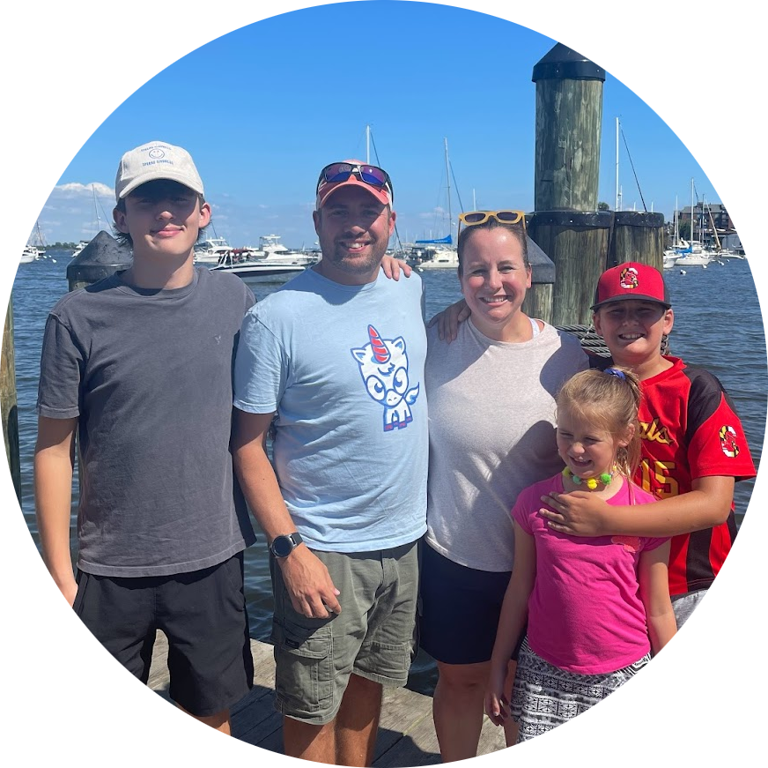






CONTACT ME
Jason van Brackel
Unicorn Engineer
@JvB
@jasonvanbrackel
jasonvanbrackel
#Zarf at https://slack.kubernetes.io
@defenseunicorns
Defense Unicorns
https://www.youtube.com/@defenseunicorns

Slide 3
Agenda
Introduction
Welcome to the Meetup
What is SBOM
Software Supply Chain and Software Bills of Material
Demo
A Quick Zarf Demo
Q&A
Your Turn!

Slide 4
Introduction to Gather
Quick Notes
Move with arrows or mouse click
’x’ to interact with objects
‘g’ to ghost through people
‘f’ to throw some confetti
’z’ dance party!

Slide 5
Supply Chain Attacks
In Silicon
https://www.hackster.io/news/researchers-spot-silicon-level-hardware-trojans-in-chips-release-their-algorithm-for-all-to-try-ba00bbd56248

Slide 6
Supply Chain Attacks
In Infrastructure
https://en.wikipedia.org/wiki/2020_United_States_federal_government_data_breach

Slide 7
Supply Chain Attacks
For National Security
https://www.reuters.com/business/media-telecom/us-fcc-bans-equipment-sales-imports-zte-huawei-over-national-security-risk-2022-11-25/

Slide 8
Supply Chain Attacks
In Code
https://www.bleepingcomputer.com/news/security/microsoft-iranian-hackers-still-exploiting-log4j-bugs-against-israel/

Slide 9

What is a Software Bill of Materials?
SBOM
A Software Bill of Materials is an inventory of the components used in the construction of a software artifact.
It is used to help secure software supply chains. And is a tool in software supply chain risk management.

Slide 10
What is a Software Bill of Materials?
SBOM
Formal
Machine Readable
May Include OSS and Proprietary Software

Slide 11
What is a Software Bill of Materials?
Components
Provenance
Keys
Signatures
Attestations

Slide 12
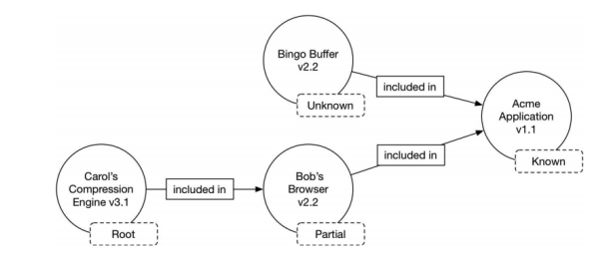
What is Provenance?
Provenance
Formal
Machine Readable
May Include OSS and Proprietary Software
https://ntia.gov/files/ntia/publications/sbom_at_a_glance_apr2021.pdf

Slide 13
KEY PAIRS
Keys
Public Key
Private Key

Slide 14
Signing
Signed Artifacts
Source Code
Binary Artifacts
Container Images

Slide 15
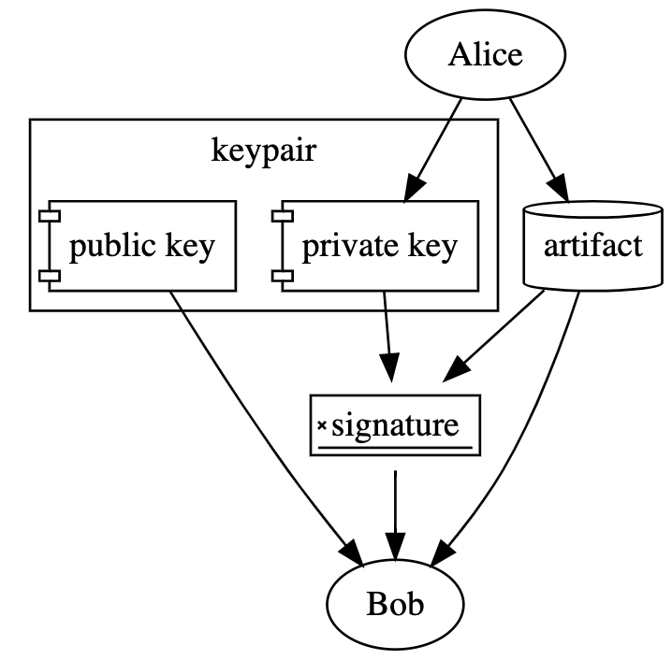
Signing
What is a Signature
https://dlorenc.medium.com/policy-and-attestations-89650fd6f4fa

Slide 16
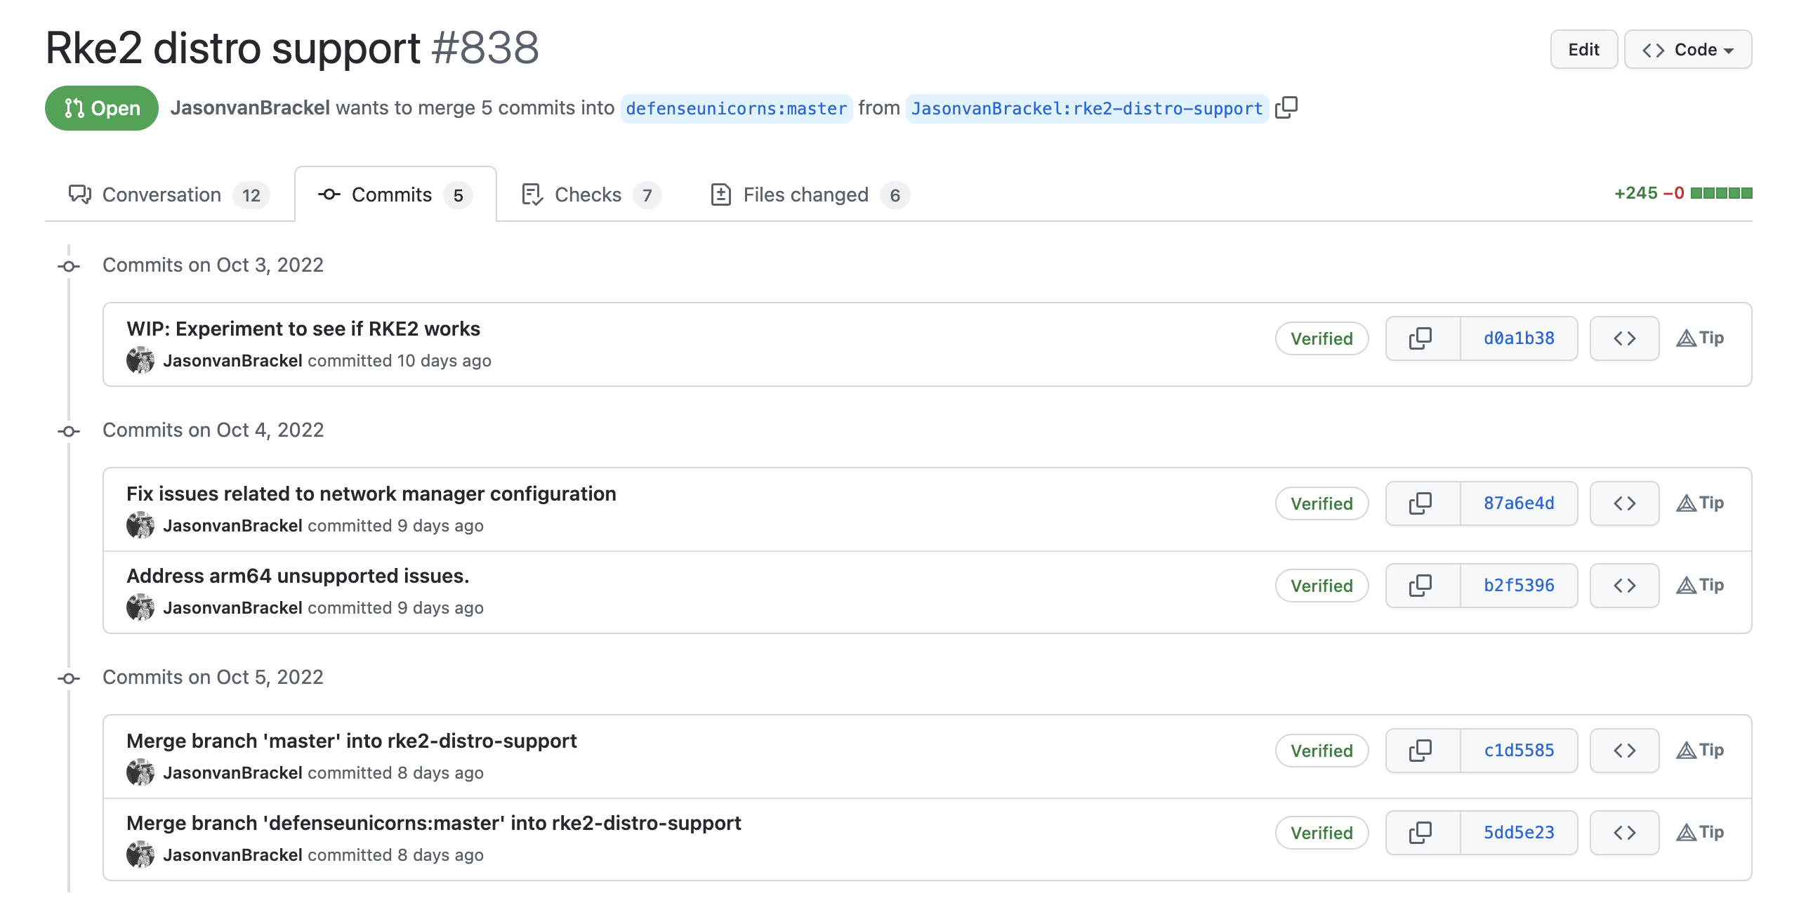
Signing
Signed Artifacts
Source Code
Binary Artifacts
Container Images

Slide 17
Signing
Signed Artifacts
Source Code
Binary Artifacts
Container Images

Slide 18
What is an attestation?
We need more
What checks were performed?
What quality gates were checked?
What about CVEs?
What was done?
When was it done?

Slide 19
Attestation
What is an Attestation?
Makes verifiable claims about provenance
Can include tests and test results.
Can tell you what scans were done
Can make claims about authorization for which automated policy decsions can be made.

Slide 20
Signing
What is a Signature
https://dlorenc.medium.com/policy-and-attestations-89650fd6f4fa

Slide 21
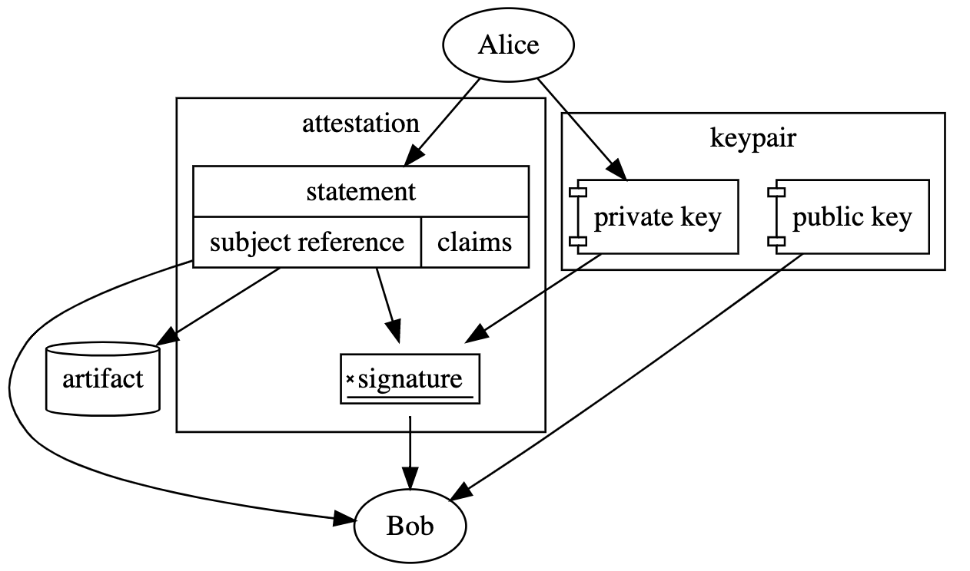
Attestation
What is an Attestation?
https://dlorenc.medium.com/policy-and-attestations-89650fd6f4fa

Slide 22
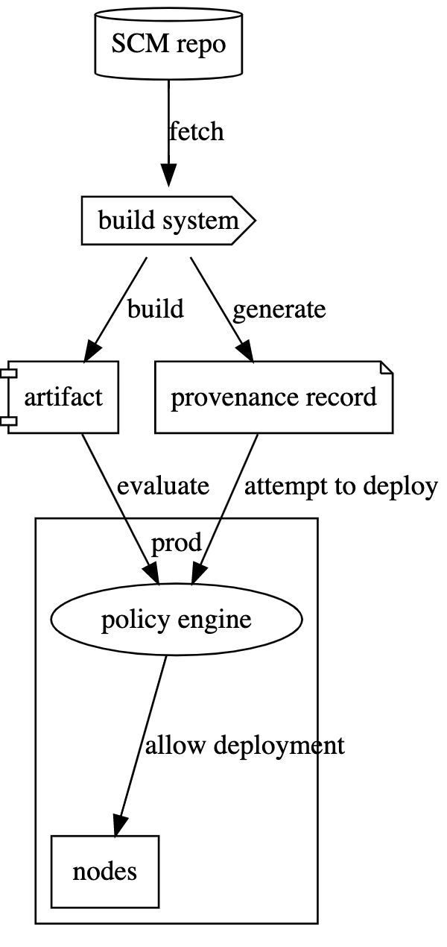
The Big Picture

Slide 23
What’s Coming
Securing Open Source Software Act
https://www.congress.gov/bill/117th-congress/senate-bill/4913/text
U.S. Senators Gary Peters (D-MI), Chairman of the Homeland Security and Governmental Affairs Committee
Josh Hawley (R-MO)
Builds on https://www.congress.gov/117/plaws/publ150/PLAW-117publ150.pdf

Slide 24
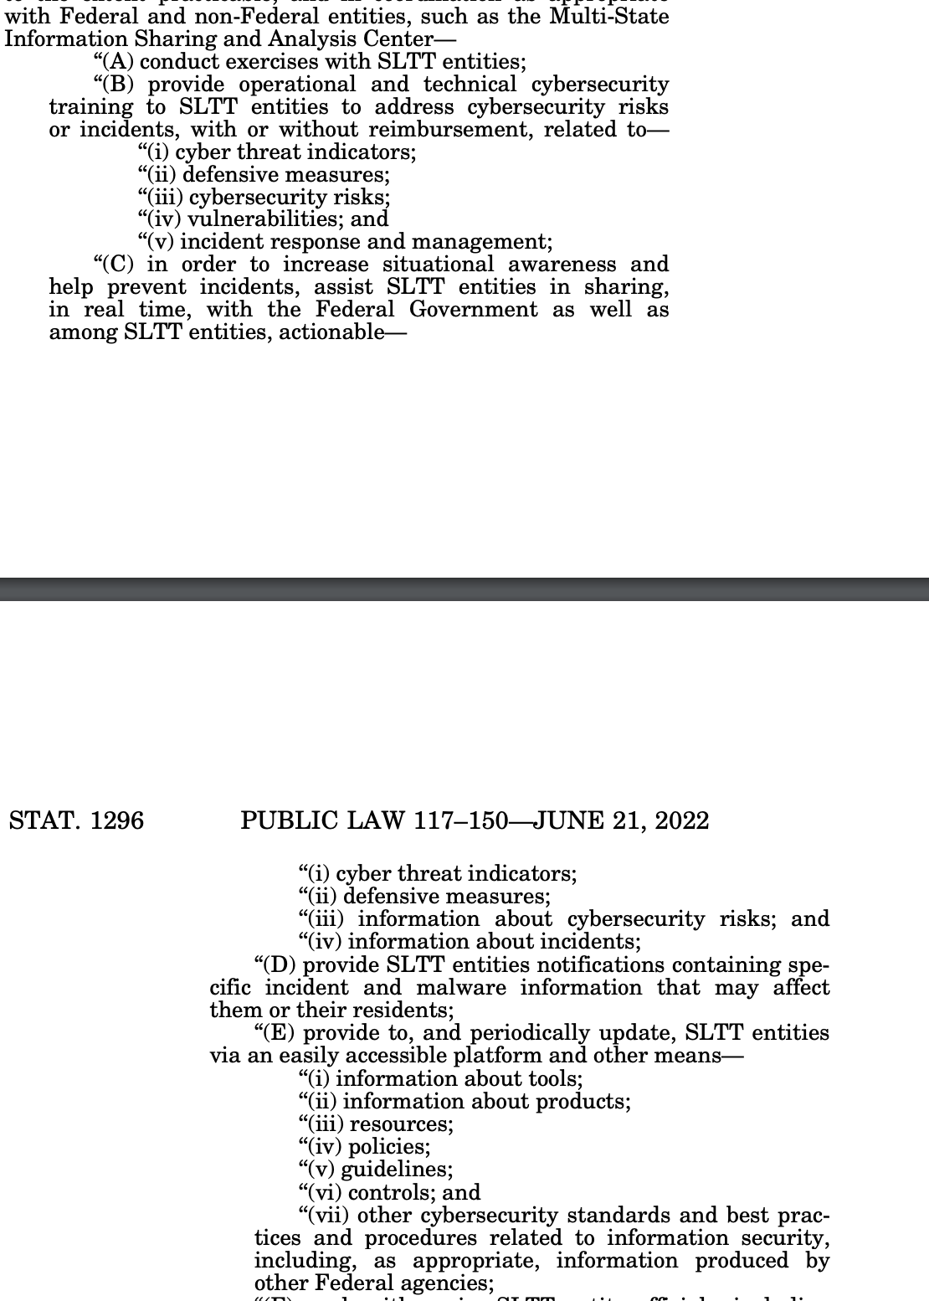

Slide 25
Where can I get Started
Hardened Images
https://ironbank.dso.mil/about
https://www.chainguard.dev/resources

Slide 26
Where can I get started?
Learn from Others
https://software.af.mil/dsop/services/
https://www.nist.gov/itl/executive-order-14028-improving-nations-cybersecurity/software-security-supply-chains-software-1
https://www.cisa.gov/sbom

Slide 27
Where can I get started?
Integrate
https://docs.sigstore.dev/cosign/overview/
https://zarf.dev

Slide 28
What is Zarf?
Zarf
Zarf is an always free, open source product that makes air-gap easy for Kubernetes.

Slide 29
Zarf
CLI
Tools for deploying and managing applications in air-gapped environments
Package
Inspect
SBOM
Deploy

Slide 30
Zarf Packages
Packages
Are the single tarball that contains everything needed to deploy your payload to its desired destination.
Defined by zarf.yaml
Two flavors

Slide 31
Zarf Packages
Packages
Zarf Packages
Zarf Init Packages
injector
registry seed
container registry
Optional
K3s
logging
git server

Slide 32
Zarf Components
Components
Make up a Package
Files, Helm Charts, Manifests, Images, Git Repos, Scripts, Data

Slide 33





Overview
Define
Package
Transport
Deploy
You Declaratively define your payload
Zarf Securly Packages, Charts, Manifests, Images, and Files
You transport your package over the wire, over the road.
Zarf deploys and verifies your payload to Kubernetes

Slide 34
What do we mean by Securely Package?

Slide 35
Zarf Demo
Demo Time!

Slide 36
ANY QUESTIONS?

Slide 37
Get In Touch
#Zarf at https://slack.kubernetes.io
@defenseunicorns
Defense Unicorns
@JvB
@jasonvanbrackel
jasonvanbrackel

Slide 38
Zarf
Connect with Zarf
https://zarf.dev
https://github.com/defenseunicorns/zarf

